Slide 1
LISTENING TO GOD
SERMON SERIES
Grow Group Discussion Questions
Notes:
Changed to Vision 2020

Slide 2
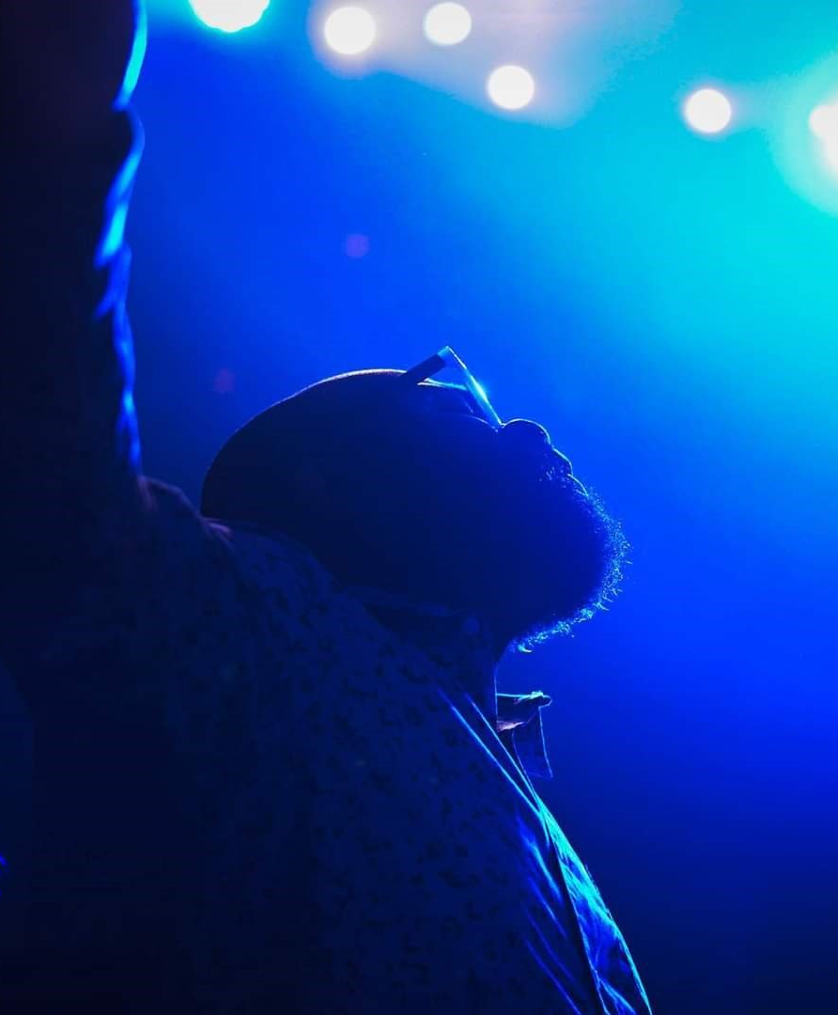
Tentative Sermon Series Schedule
April 24, 2022 God Still Speaks 1 Samuel 3:1-18
May 8, 2022 TBD
May 15, 2022 TBD
May 22, 2022 TBD
May 29, 2022 TBD
Notes:
Condensed 4 pages back into one. Need to design.

Slide 3
Listening To God: God Still Speaks April 24, 2022
1 Samuel 3:1-18
SERMON NOTES:
God speaks through Scripture.
God speaks through people.
God speaks through the Spirit.
God speaks through open and closed doors.
God speaks through moments.
DISCUSSION QUESTIONS:
Why is it so difficult to hear God’s voice?
Have you ever heard God’s voice speak directly to you? If so, share the experience.
God speaks through scripture, His people, His Spirit, open & closed doors, and moments…which of these ways do you need to trust God more to speak to you? Why?
What are some of the distractions that you need to address that keep you from hearing God?
Read John 10:27. Based on your reading, what does following God have to do with hearing God?
Sermon Playback

